Slide 1
Microsoft Ignite

Slide 2
Delivering a multi-tenant Azure platform with a single deployment
Zachery Olinske
Matthew Greenham
Erhan Sanlioglu

Slide 4

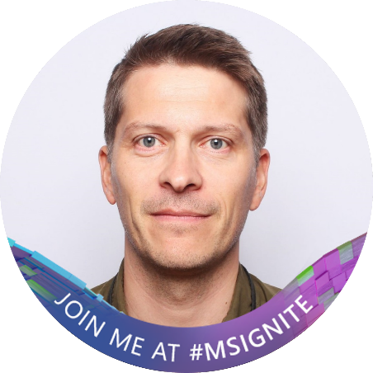
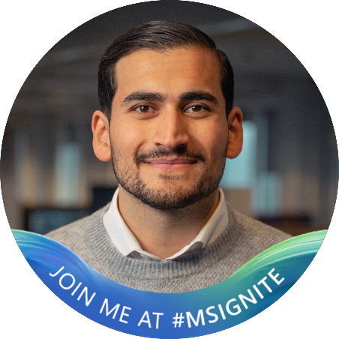
Speakers
Zachery Olinske
Cloud Solution Architect
Microsoft Norway
Matthew Greenham
Azure Team leader
SpareBank 1 Utvikling
Erhan Sanlioglu
Azure Platform Developer
SpareBank 1 Utvikling

Slide 5






Some of the brands in the SpareBank 1 Alliance

Slide 6

SpareBank 1 is a family of 13 independents banks with strong local connections across the whole of Norway.
Our shared brand is governed by SpareBank 1 Utvikling

Slide 7


13 independent SpareBank 1 banks in Norway

Slide 8


Slide 9





Azure Landing Zone
CAF & ALZ
Tenants and billing
IAM
Security
DevOps
Azure DevOps
Code repository
Project planning / kanban board
pipelines (CI/CD)
Management
Azure Bicep
Infrastructure as Code
Declarative Infrastructure
Networking
Governance
Cloud Adoption Framework
Resource
Organization
Multi-Tenant deployment

Slide 11
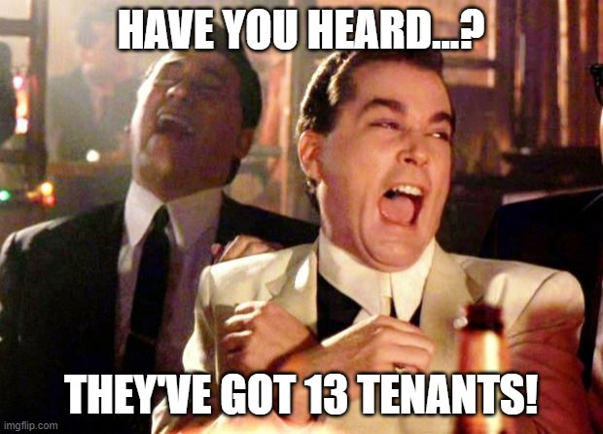

Slide 13











Main network topology
SpokeTenant
SpokeTenant
SpokeTenant
Core Subscriptions
Landing Zones
Core Subscriptions
Landing Zones
Core Subscriptions
Landing Zones
Hub Tenant
Vwan Hub
Connectivity
Landing Zones
Internet
AzFirewall (Mgr)
On-Prem

Slide 15

Core Pipelines
core-00-root
Landing Zone Pipelines
Responsible for creating core platform subscriptions
lz-00-subscriptions
core-01-management
Responsible for creating Landing Zones
Responsible for creating centralized resources for management subscription
lz-01-networking
core-02-policy
Responsible for creating ASG, NSG, vnet and
vwan connection for Landing Zones
Responsible for creating policy definitions, initatives and assignments
core-03-con-vwan
Responsible for creating vwan, hub, firewall, vpn s2s
core-04-con-fw-rules
Onboarding Pipelines
Responsible for creating IPGroups and firewall rules
core-05-networking
Eunomia-Onboarding
Responsible for creating ASG, NSG, vnet and vwan connection for core subscriptions
Responsible for creating repo, variable group, management group hierarchy, SP, PIM
core-06-dns
Responsible for creating the DNS servers

Slide 16

Onboarding Prerequisite
EA-Service Account
secondTenant
Enrollment account(Guest)
Sparebank1 tenant

Slide 18
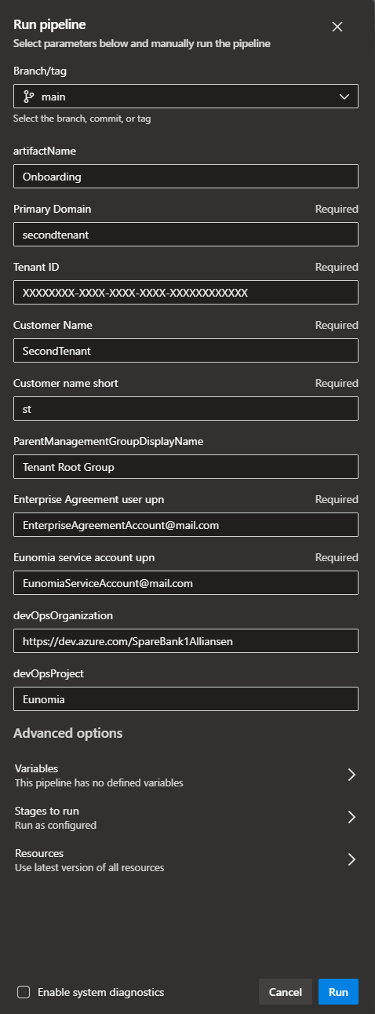







Onboarding a new tenant
Pipelines
eunomia-secondtenant
Eunomia-Onboarding
Tenant repo
networking.json
Variable group
base.json
Mgmt group
Service Principal
SecondTenant
Azure AD Groups
PIM Configuration
Eunomia
Core
LandingZones
Sandbox
Staging
Decom
Public
Private

Slide 19


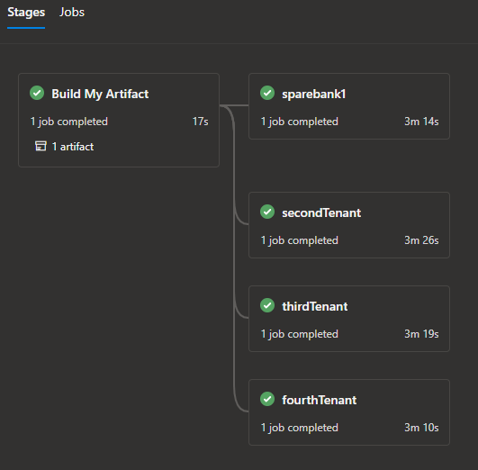
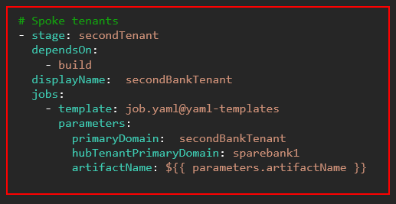
Multi-tenant deployment
Yaml-templates
prod-stage-tenants.yaml
parameters:
- name: artifactName
stages:
# HUB tenants
- stage: sparebank1
dependsOn: build
displayName: sparebank1
jobs:
- template: job.yaml@yaml-templates
parameters:
primaryDomain: sparebank1
hubTenantPrimaryDomain: sparebank1
artifactName: ${{ parameters.artifactName }}
core-00-root
core-01-management
core-02-policy
core-03-con-vwan
core-04-con-fw-rules
core-05-networking
core-06-dns
Lz-00-subscriptions
Lz-01-networking

Slide 20
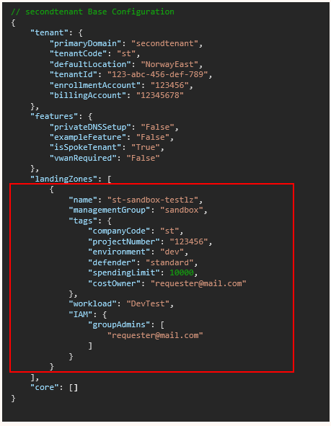






eunomia-secondTenant
base.json
networking.json
SecondTenant
// secondtenant Base Configuration
{
"tenant": {
"primaryDomain": "secondtenant",
"tenantCode": "st",
"defaultLocation": "NorwayEast",
"tenantId": "123-abc-456-def-789",
"enrollmentAccount": "123456",
"billingAccount": "12345678"
},
"features": {
"privateDNSSetup": "False",
"exampleFeature": "False",
"isSpokeTenant": "True",
"vwanRequired": "False"
},
"landingZones": [],
"core": []
}
lz-00-subscriptions
Subscription
Resource Providers
Eunomia
Defender
Activity Log Export
Tags
Core
LandingZones
Sandbox
Staging
Decom
Budget
Azure AD Groups
PIM Configuration
Public
Private
st-sandbox-testlz

Slide 21
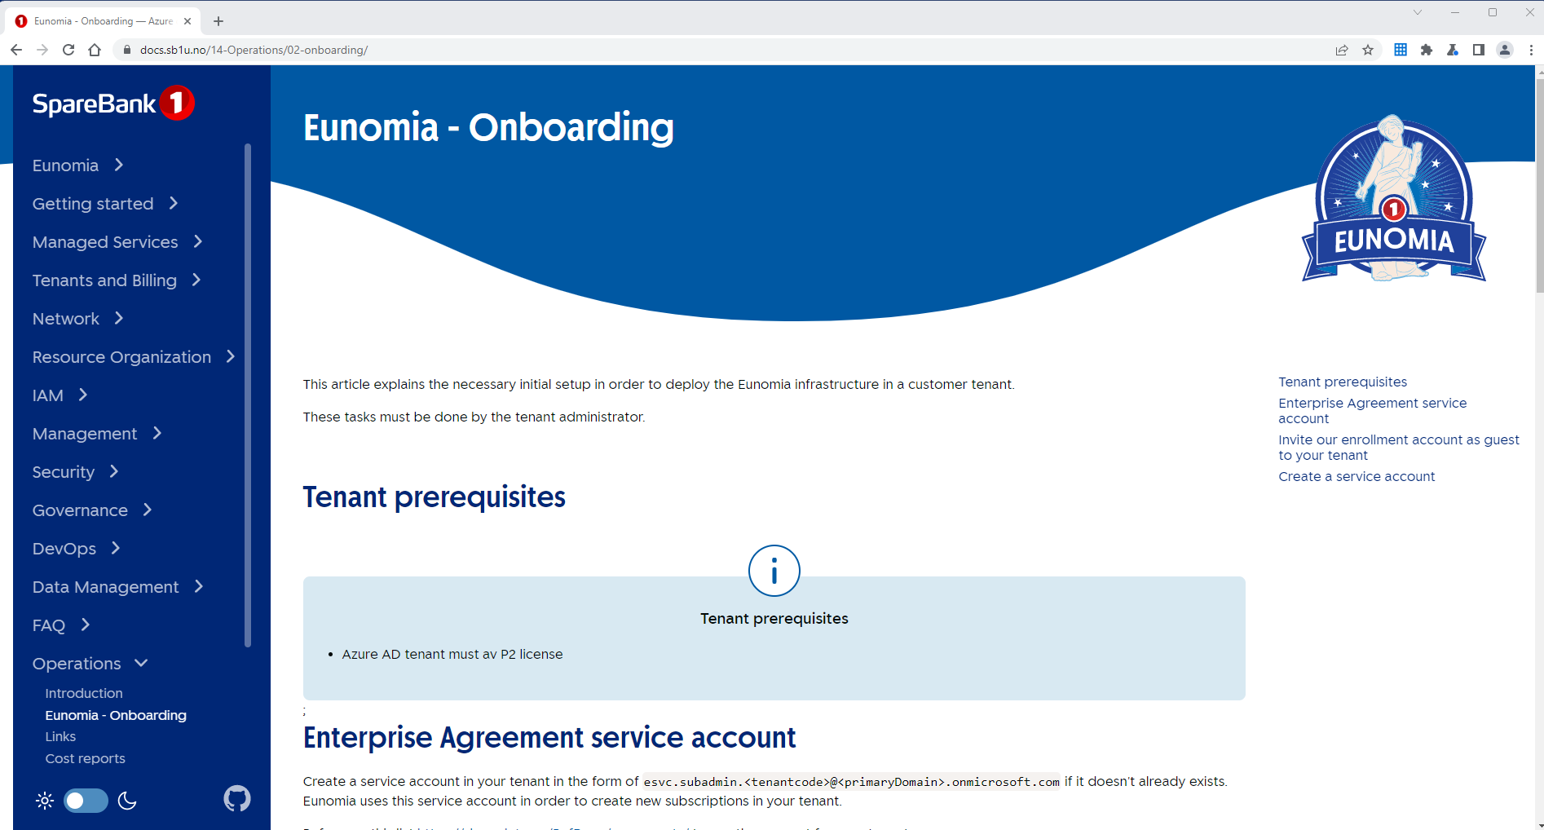
Eunomia - Docs

Slide 23
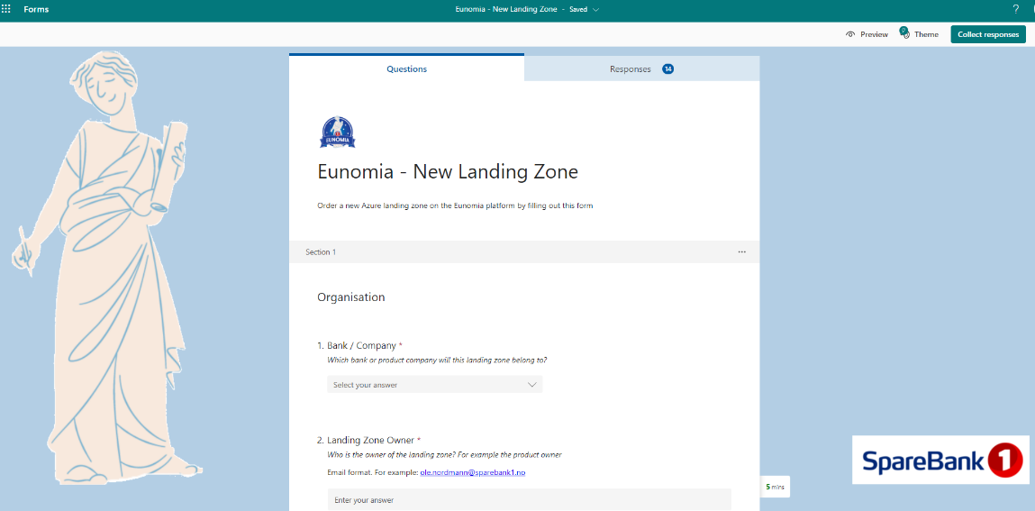
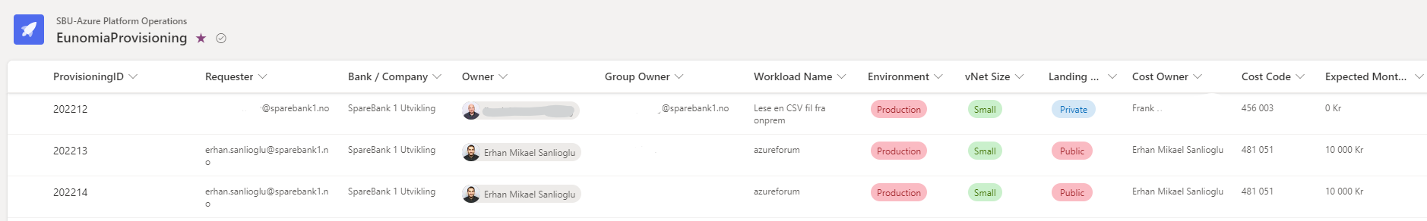
How do end users request new Subscriptions?
Different ordering process per tenant / company
MVP – Forms – SPO – JSON - Pipeline automation
Config file changes. Working on further improvements for automation

Slide 25

Challenges
Understanding ALZ
Management Group hierarchy
Organizing the team
Testing
Pipeline setup
Private Link (DNS)

Slide 26

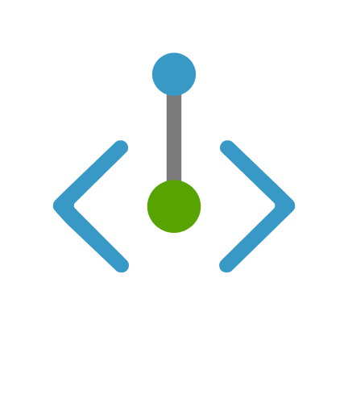

DNS with PrivateLink
Spoke Tenant 1
Spoke Tenant 2
st1kv.privatelink.vaultcore.azure.net
st2kv.privatelink.vaultcore.azure.net
Hub Tenant
Vwan Hub
privatelink.vaultcore.azure.net
st1kv
AzFirewall (Mgr)
st2kv
On-Prem

Slide 28

Key learnings
Build iteratively
Fail fast
Think of your customers (internal dev platform)
Keep it simple!

Slide 29
Key learnings
Build iteratively
Fail fast
Think of your customers (internal dev platform)
Keep it simple standardised!

Slide 31



Learn more…
https://learn.microsoft.com/en-us/azure/cloud-adoption-framework/
https://github.com/Azure/ALZ-Bicep
https://www.linkedin.com/company/sparebank-1-utvikling
https://github.com/sparebank1utvikling/Ignite2022
https://www.kode24.no/artikkel/sann-lager-sparebank-1-sin-nye-skyplattform-tidlig-ute-med-bicep/77426381

Slide 32
Q & A

Slide 33
Microsoft Ignite

